Slide 1

Global Ethical Issues & Ethical Codes
MODULE – IV

Slide 2
CONTENTS
1. Global Ethical Issues
(a) Ethical Issues in Business
(b) Environmental Ethics
(c) IT Ethics
(d) Bioethics
(e) Intellectual Property Rights (IPR)
(f) Ethics in Research
(g) Media Ethics
(h) Corporate Social Responsibility (CSR)
2. Ethical Codes
3. Limitations of Ethical Codes

Slide 3
GLOBAL ETHICAL ISSUES
Global Ethical Issues refer to moral challenges and dilemmas that extend beyond national boundaries and affect individuals, organizations, and societies across the world. These issues arise due to globalization, rapid technological advancement, industrial growth, and increased interconnectedness among nations.
They require a balance between economic development, human welfare, and environmental sustainability. Global ethical issues are not confined to one sector—they span across business, environment, information technology, healthcare, media, and research.
Overall, global ethical issues demand collective responsibility, ethical awareness, and informed decision-making from professionals, especially engineers and managers, to ensure sustainable and just development in a rapidly evolving world.

Slide 4

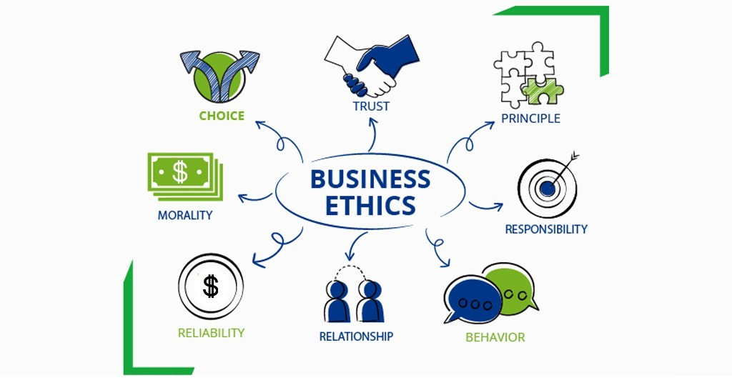
Ethical Issues in Business
Business ethics refers to applying moral principles in business activities—deciding what is right and wrong in corporate actions.
KEY ETHICAL ISSUES
Profit Vs Ethics
Transparency and Honesty
Employee Welfare
Customer Rights
Fair Competition
Should a company increase profit by lowering product quality?
Is it acceptable to mislead customers through advertising?
Is saving company reputation more important than customer safety?

Slide 5
Ethical issues in business arise when companies face conflicts between profit-making and moral responsibility. These include unfair labor practices, misleading advertisements, corruption, and lack of transparency. Businesses are expected to operate honestly while ensuring fairness to employees, customers, and society. A mobile company hides battery defects to avoid losses.
Profit vs Safety — what should be prioritized?

Slide 6
🌱 Environmental Ethics
It is concerned with moral responsibility towards protecting the environment and ensuring sustainability.
CORE PRINCIPLES
Sustainable Development
Conservation Of Resources
Pollution Control
Intergenerational Equity (Future Generations’ Rights)
Dumping untreated waste into rivers
Overuse of fossil fuels
E-waste mismanagement
MAJOR ISSUES
Air and water pollution
Climate change
Deforestation
Industrial waste

Slide 7
Environmental ethics focuses on the responsibility of individuals and organizations to protect nature and use resources sustainably. Issues such as pollution, climate change, and deforestation highlight the need to balance development with environmental conservation. A factory reduces cost by skipping pollution control systems.
Short-term profit vs long-term environmental damage?

Slide 8

💻 IT Ethics
It Deals with ethical use of computers, data, and technology.
KEY AREAS
Data privacy
Cybersecurity
Intellectual property
AI ethics
ETHICAL ISSUES
Hacking
Identity theft
Data misuse
Fake news
Unauthorized access to personal data
Using pirated software
Social media manipulation

Slide 9
IT ethics deals with the responsible use of technology and data. It includes concerns like data privacy, cybersecurity, hacking, and misuse of digital information. Ethical IT practices ensure trust, security, and fairness in the digital world. A software engineer accesses user data secretly.
Is it ethical if no one gets caught?

Slide 10

🧬 Bioethics
Ethical issues arising in biology, medicine, and biotechnology.
KEY TOPICS
Genetic engineering
Cloning
Stem cell research
Organ transplantation
⚖️ ETHICAL CONCERNS
Playing with human life
Consent and safety
Human dignity
Creating “designer babies”
Animal testing
Organ trade

Slide 11
Bioethics involves ethical questions in medicine, biology, and life sciences. It addresses issues like genetic engineering, cloning, and organ transplantation, focusing on human dignity, consent, and the limits of scientific intervention.
Where should we draw the line?

Slide 12
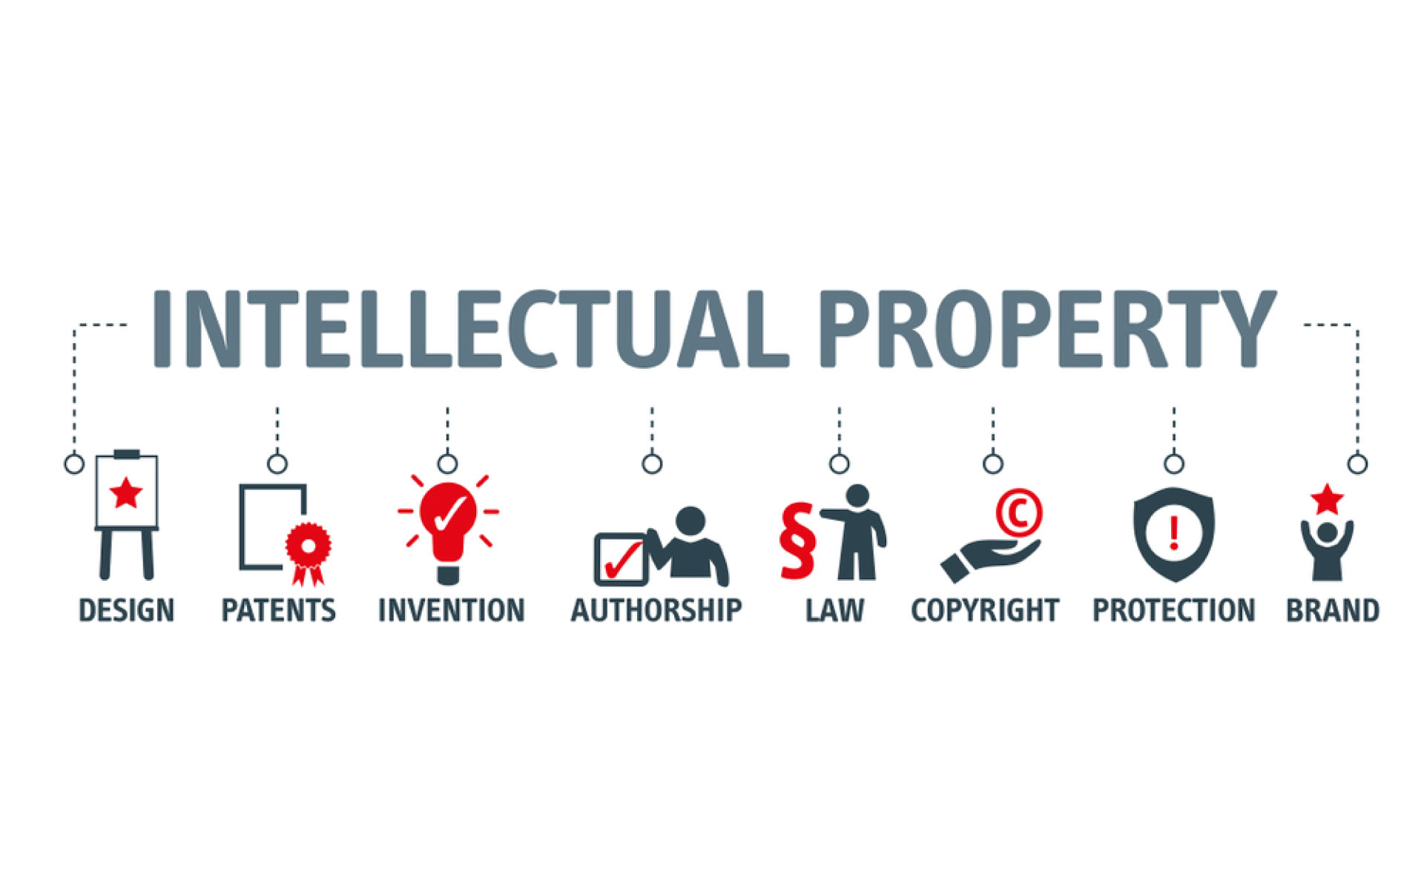
📜 Intellectual Property Rights (IPR)
Legal rights protecting creators’ inventions, designs, and ideas.
TYPES
Patent → invention
Copyright → books, software
Trademark → brand name/logo
ETHICAL ISSUES
Plagiarism
Software piracy
Patent misuse
Copying project work
Downloading pirated movies/software

Slide 13
IPR refers to the legal rights that protect creations of the mind, such as inventions, designs, and artistic works. Ethical concerns include plagiarism, piracy, and unauthorized use of others’ work. A student copies a project from the internet.
Is it innovation or Theft?

Slide 14
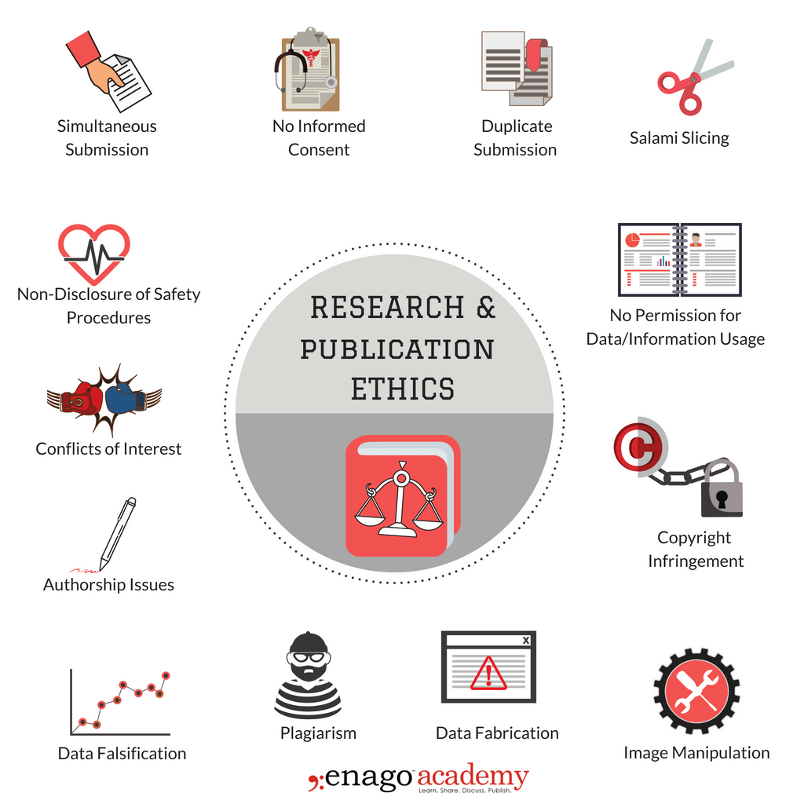
🔬 Ethics in Research
Ensuring honesty, integrity, and accuracy in research activities.
PRINCIPLES
Honesty
Objectivity
Transparency
Accountability
UNETHICAL PRACTICES
Plagiarism
Data fabrication
Data falsification
Copying others’ research
Changing data to get desired results

Slide 15
Ethics in research ensures honesty, integrity, and accuracy in scientific and academic work. It discourages practices like plagiarism, data manipulation, and falsification of results. A researcher changes results to publish a paper.
Success vs Honesty

Slide 16
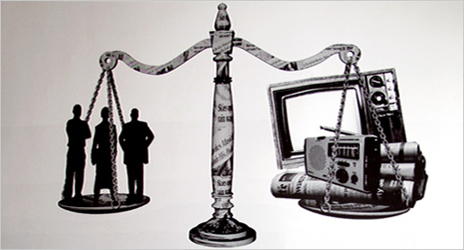
📺 Media Ethics
Moral principles guiding journalism and media communication.
CORE VALUES
Truthfulness
Objectivity
Fairness
Responsibility
ISSUES
Fake news
Sensationalism
Bias reporting
Spreading rumors without verification
Showing only one side of a story

Slide 17
Media ethics focuses on truthful and responsible reporting. It deals with issues like fake news, bias, and sensationalism, emphasizing the need for accuracy and fairness in communication. News channels exaggerating facts for TRP.
Information vs Manipulation

Slide 18
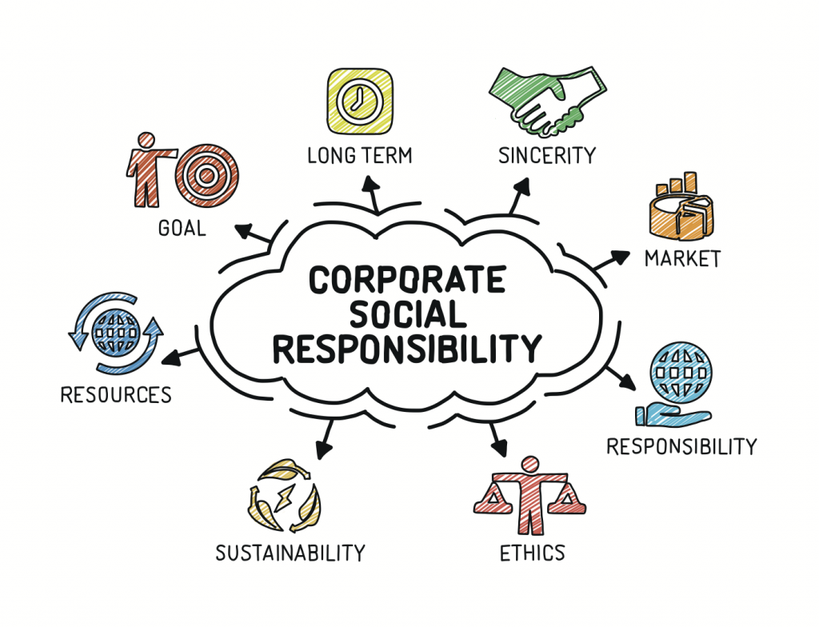
🤝 Corporate Social Responsibility (CSR)
Responsibility of companies towards society beyond profit-making. CSR is the duty of businesses to “give back” to society while doing their business.
AREAS OF CSR
Education
Healthcare
Environment
Rural development
Building schools
Donating to NGOs
Environmental campaigns

Slide 19
CSR refers to a company’s responsibility to contribute positively to society. It includes activities related to social welfare, environmental protection, and ethical business practices beyond profit-making. A company earns huge profit but does nothing for society.
Is profit enough?

Slide 20
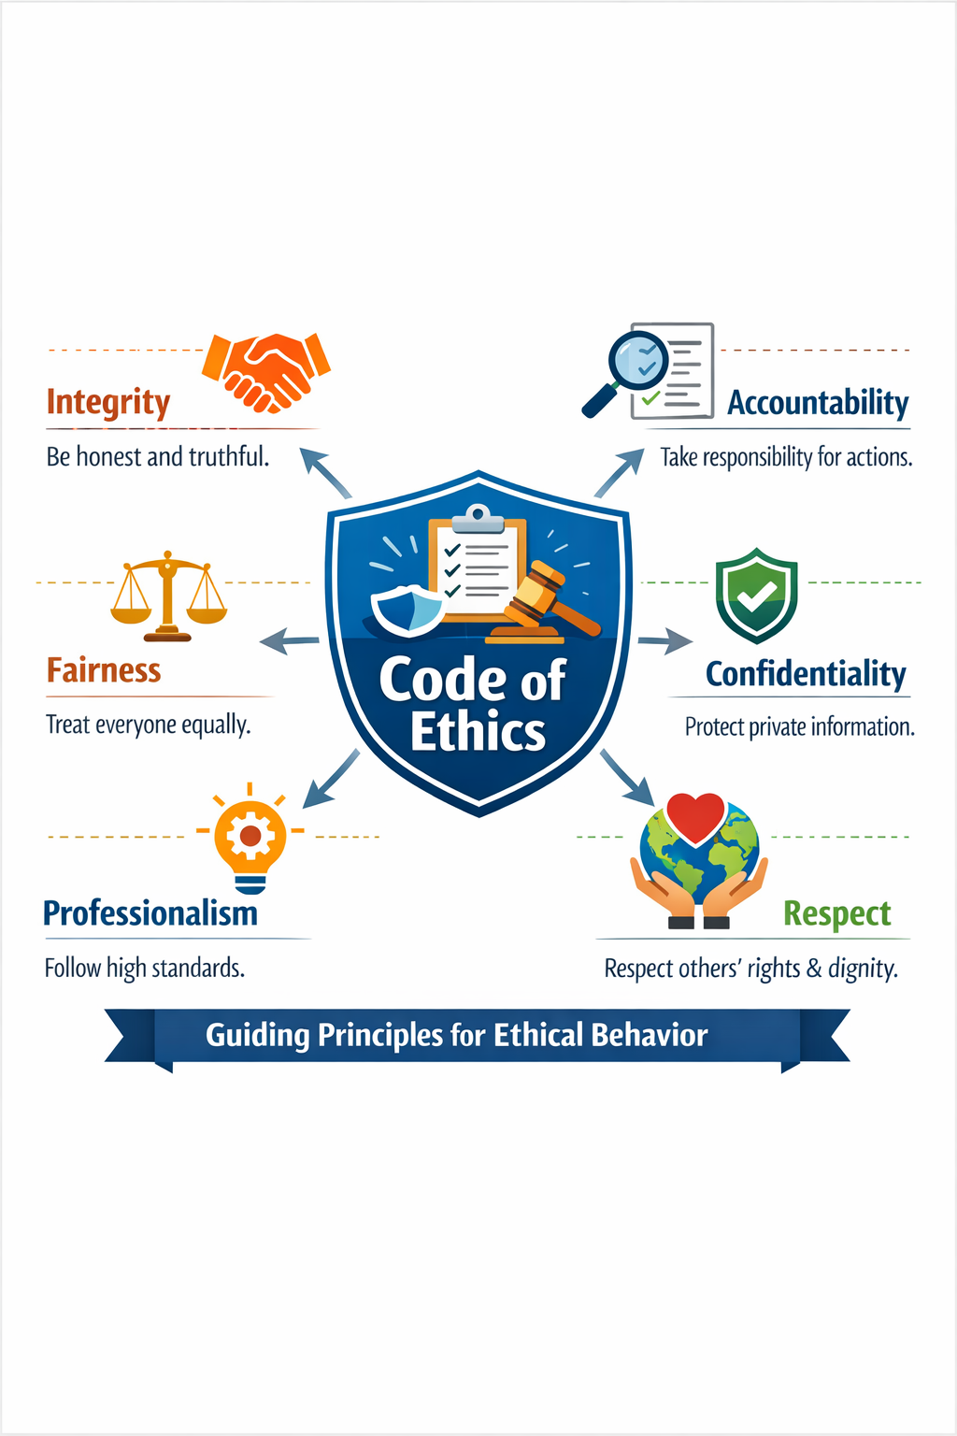
ETHICAL CODES

Slide 21
📜 Ethical Codes
Ethical codes are formal guidelines or rules that help professionals decide what is right and wrong in their work. They act as a moral framework that ensures honesty, integrity, responsibility, and fairness in professional behavior. Ethical codes guide decision-making, build public trust, and help maintain standards within a profession, especially in fields like engineering where safety and accountability are important.
IMPORTANCE / SIGNIFICANCE
Guides Behavior: Helps engineers make correct decisions
Builds Trust: Society trusts ethical professionals
Improves Professionalism: Maintains discipline and standards
Prevents Misconduct: Reduces corruption, fraud, negligence
Protects Public Safety: Especially important in engineering projects

Slide 22
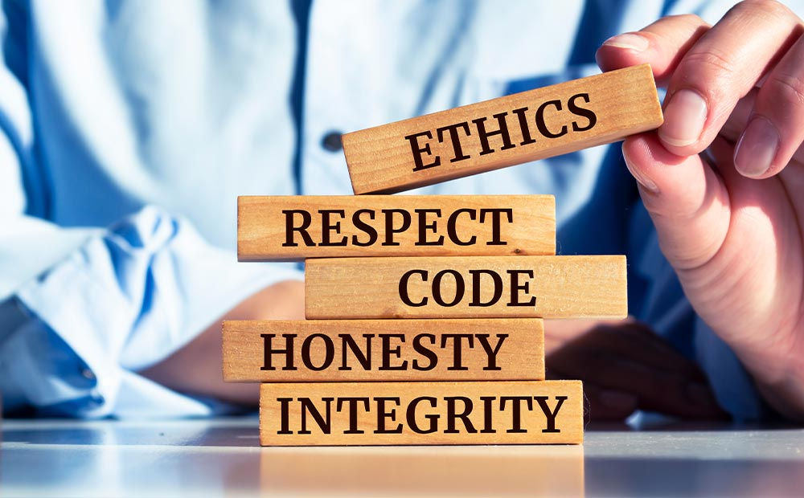
Limitations of Ethical Codes
Not Comprehensive: Cannot cover all situations
Interpretation Issues: Different people interpret differently
Lack of Enforcement: Not always strictly followed
Conflict of Interest: Personal gain may override ethics
Cultural Differences: Ethics vary across regions
Features of Ethical Codes
Written guidelines
Profession-specific
Helps in decision-making
Maintains standards

